Slide 1
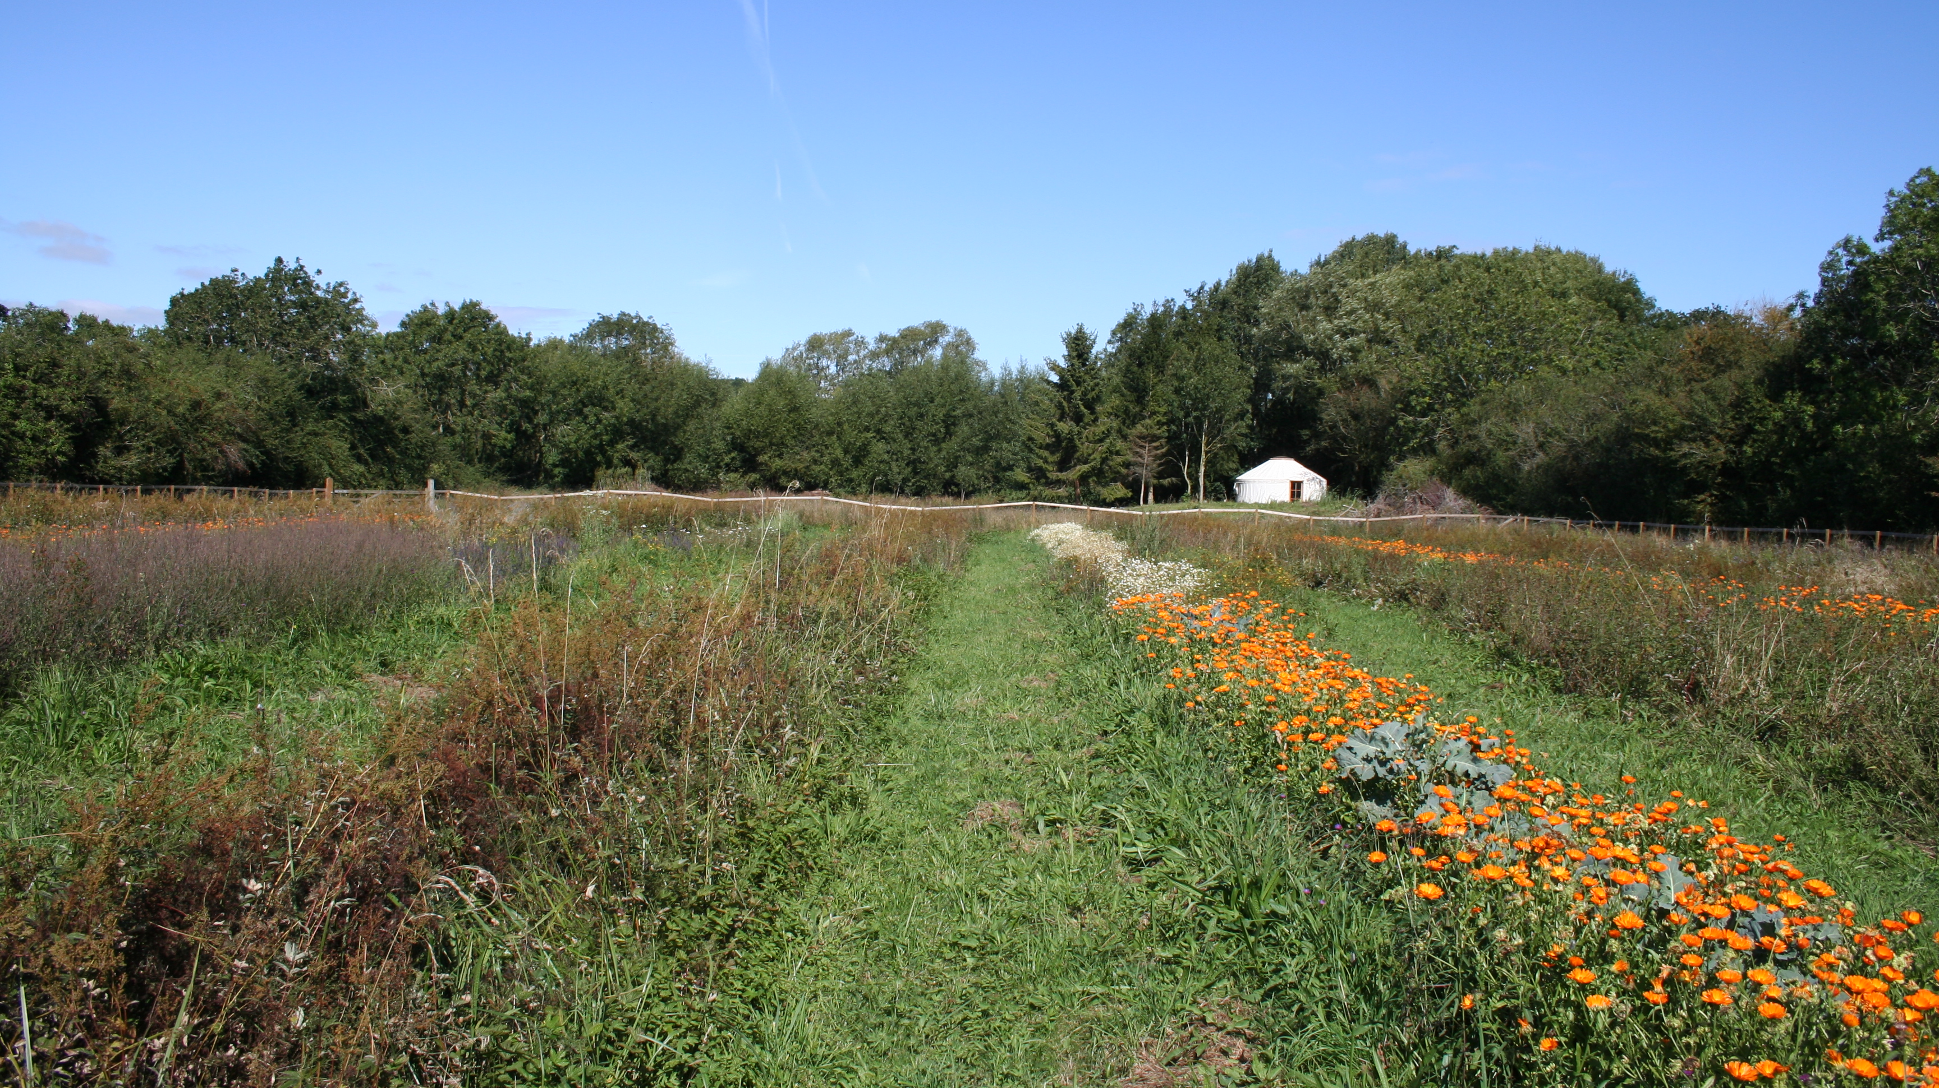
A Growing Plan

Slide 2
overview
Aim | To decide if growing food and flowers at Brookside is feasible, for us and for the folk of Brookside
Date | 24.06.22 -
Location | Brookside Farm
Client | Us and Brookside Farm
Status
Area of Application
Principles
Framework | The Regenerative Life framework and Living Systems/Holistic Decision Making
Tools | HDM for ‘objectives’
Resources/support
Context | Myself and my partner Killian are at Brookside Farm and we can see lots of potential for growing food and flowers, maybe even grow seed crops. There is a field which is predominantly used for growing herbs, which are distilled and made into drinks.

Slide 3
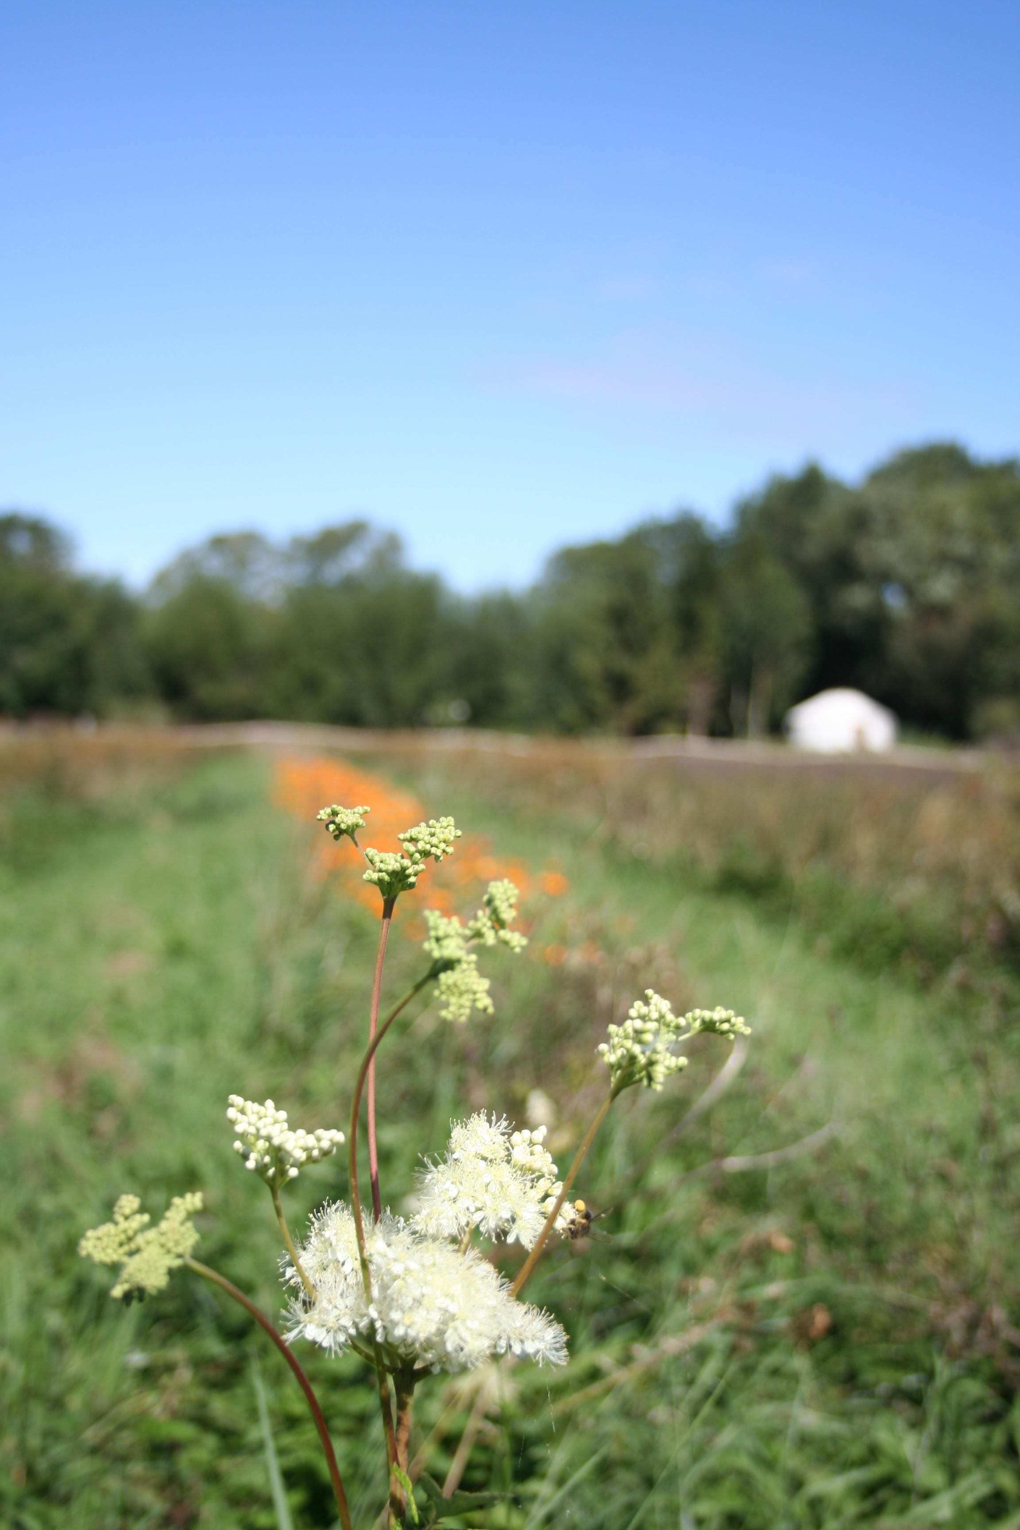
Introduction
We would like to make a thorough investigation into the feasibility of growing oppotunities at Brookside Farm
The farm is…
We are…
It seems like it’s a potential opportunity so …
This will also provide us with a proposal for Katie and Anthony, the owners of the farm.

Slide 4
Ideas
Start small, just growing for the farm. If there’s scope for expansion at a later date, do that.
Grow just for the people on the farm – is this necessary as they get a veg box from Canalside CSA
Grow flowers for Rosemary’s floristry …thing
Plant sales
Aquaponics
Polytunnel
Grow select crops to sell, starting v small and building this gradually
Wicking beds
Move all herbs down to field?
Can the ‘rose garden’ be predominantly a kitchen garden? Raised beds by the hive for roses/kitchen herbs
Rain gardens in planters?
Rent a bit of Ian’s motocross field??!
Perennial edibles area

Slide 5
Framework
Carol Sanford – A Regenerative Life
Levels of Paradigm; which paradigm are you currently operating from and how could you move yourself up to the Regenerate Life Paradigm?
Seven First Principles of Regeneration; assess the coherence and wholeness of your choices and actions
Inner Obstacles: observe energy drains that undermine your efforts at improvement and articulate them in terms of inner obstacles

Slide 6
Levels of Paradigm
Carol Sanford – A Regenerative Life
The first step is to become aware that the levels exist and that it is possible to make choices with regard to them
Which paradigm are you currently operating from and how could you move yourself up to the Regenerate Life Paradigm?
Regenerate Life – how to build the capacity in people and other living systems to be self-determining in the world. Seek what is essential in each person and every sort of thing that is the subject of our work
Do Good – faith in the potential of things and people to improve and make more meaningful contributions to the world. Motivated by potential we see, to make the world a better place
Arrest Disorder – reduce waste and dysfunction, looking at the immediate consequences of our actions
Value Return – reproduce a pattern of behaviour or action in order to achieve predictable results
Task – reflect on your previous designs with regard to the levels – which have you been working from?

Slide 7
Reflection on Levels of Paradigm in Previous Designs
Task – reflect on your previous designs with regard to the levels – which have you been working from and what impact has this had on your work?
Summary
I can see aspects of each of the four levels within my designs. You could say that they all essentially aim to increase the capacity of people and living systems. There is quite a lot of Arrest Disorder and Do Good, that is for certain. And that is a valid approach in many of the situations. I used the best approach I had at my disposal.
In the early stages of my portfolio I wanted clear frameworks, to know what went where, in which category. I wanted to ‘avoid the risks […] that come from striking out on an untried path’ (Sanford).
By design 8 and 9 I was still somewhat confused by the difference between evaluation and reflection, but I was also frustrated by having to categorise them, it felt counterproductive and box ticky. This was my desire to move away from this fragmenting activity.
Throughout my diploma, I have been driven by the vision that there is so much potential for ourselves and the world. But this has perhaps been part of the reason why I have felt so frustrated, because my approach has been to impose my ideas upon people/living systems.

Slide 8
Seven First Principles of Regeneration
Carol Sanford – A Regenerative Life
The first set of practices is to understand that;
Any being/living system can be seen as a
Whole that has
Potential as the result it is own special being, and an
Essence that is like no other
The second set of practices is to see that the necessary sustenance that a living entity receives by being
Nested within and making contributions to a larger system, so that I can recognise how to intervene in ways that are
Nodal in order to produce a prime, higher-order effect that creates the conditions for beneficial growth, fostering as a result of
Field of creative energy that makes it possible for living beings to bring forth the best they are capable of, individually and collectively

Slide 9
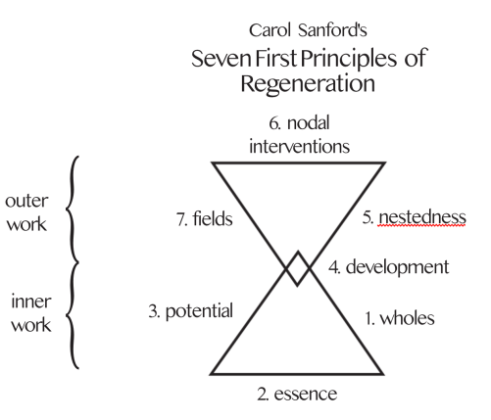
Seven First Principles of Regeneration
Carol Sanford – A Regenerative Life

Slide 10
Seven First Principles of Regeneration
Carol Sanford – A Regenerative Life
Whole - Start by seeing something as it presents itself in it’s entirety, independent of any analysis.’
The whole in this design is the current horticultural operations.
It is ‘a living whole that we encounter with our own whole being and can respect for its singular and independent existence.
It is the land, the herb field, the aspen trees, the brook, the fences, the meadowsweet, the roses, the ridges and furrows, the moths, the barn owl, the pond, the sunshine, the bees, the thistles, the ash trees, the rose garden, the rain, the tractor, the workshops, the vegetable plants, the pelargoniums, the bindweed, the tripod ladder, the tool shed, the WET system, the caterpillars, the pigeons, the wind, the soil, the willow barn, the volunteers, the shredder, the distillery, the harvest, the produce, the paths, the greenhouse, the hose, the frost, the robin, the seed, the hotbin

Slide 11
Seven First Principles of Regeneration
Potential
What potential could be manifested if there were no limits?
When people come through the gates, they see lots of greenery and flowers in raised beds – roses growing up the supports outside the Hive, a trellis up the side of the Hive, covered with plants. The planters are filled with flowers and kitchen herbs. The garden to the right is a full, productive kitchen garden, with an area where visitors can relax.
The garden in front of the house is dedicated to cut flower growing, and is full of flowers.
The car park is divided with raised beds, full of flowers and herbs.
In the greenhouse, an aquaponics system produces an abundance of vegetables.
In the lean-to is a jungle of houseplants
The area behind the workshops has a polytunnel and a lovely covered seating area for people to relax. The area along the east side of the barn has a greenhouse.
The caravan is clad with wood and has a turf roof.
In the WET system there is a good sized vegetable patch.
To the left as you pass the area where the bonfire is, there’s a fenced off area for growing veg.
A chicken tractor is making good use of the strip that leads down to the field.
Within the field there are veg beds, growing veg and seed crops alongside the herbs.
The compost systems produce a variety of media, and all are high quality and enrich the soil.
The system is a closed loop, with no need for imported materials. There is enough food for everyone on the farm, and a surplus to sell to the wider community.
People who come to work on the land connect to the stillness and are nourished by it.
We rent part of the neighbour’s trail bike practice field and grow veg there to sell to the wider community
There are several pockets of perennial edibles throughout the site, providing more diversity, and increasing the abundance

Slide 12
Seven First Principles of Regeneration
Potential, continued
What is the relationship between the inherent character or qualities of the whole (which are enduring) and how could they be called forth and expressed within a given context (which is continuously changing)
What are the inherent character or qualities of the whole?
A naturalistic biodiverse growing environment,
A calm, relaxed and loosely structured, improvisational approach to the work
The improvisational approach could be steered towards an iterative approach – Lean Farm systems
How do I know if this is the potential, or just what I am projecting? Many people who visit Brookside comment on the calmness of the place, and some have been moved to tears by it.
The potential that I see may just be my imposition…well, it will be interesting to find out! I would say that this isn’t just my vision, I know that this is in line with what other people would like to see happen.
I will include a section in my client questionnaire about what potential other people see.
Action
I will use this process within the ‘interview’ with members of the Brookside community

Slide 13
Seven First Principles of Regeneration
Essence
The irreducible core of a person or living system
How do we put what Brookside’s essence is into words? I don’t see how this is possible, at this stage!

Slide 14
Seven First Principles of Regeneration
The second set of practices is to see that the necessary sustenance that a living entity receives by being;
nested within and making contributions to a larger system,
The growing operations are nested within the broader operations of Brookside Farm. It is sustained by the land and the ecosystem that exists there, people each other, the household income
How it contributes – a place for meaningful work for volunteers and residents, connection to the land, provision of food, materials for herbal drinks, employment for Bianca

Slide 15
Seven First Principles of Regeneration
The second set of practices is to see that the necessary sustenance that a living entity receives by being nested within and making contributions to a larger system, so that I can recognise how to intervene in ways that are;
Nodal in order to produce a prime, higher-order effect that creates the conditions for beneficial growth,
Where are the nodes that will bring about the prime, higher order effect?
Not to be a drain, to be supported by other systems and to support other systems, not to be things that we might assume we would need – to remove oneself from the process
How do we ‘merge with the subject of our inquiry’? Perhaps by using the CS framework as a tarting point for the conversations we have with everyone involved.
They concentrate into a single concept or intervention the potential for transforming the whole of a system.
We need to merge with the subject of our inquiry, experiencing it from the inside and surrendering all of our preconceptions about it.
Scan the patterns of activity or change for the highly charged places of concentration where something new can burst forth into existence.
They have us at the moment. Are we nodal? Could our enthusiasm be the catalyst?
Is it something around the energy of the distillery and herbal drinks production? Can the horticultural operations be developed so as to support Katie and Bianca with their work? Katie is stretched, Bianca seems to be a bit disinterested. What is going on there?
This isn’t about looking at the inputs/outputs diagram and seeing where the connections are, we can drop this for this part of the process
This is a point at where Killian and I have a slightly different perspective, as he thinks that the inputs/outputs diagram is…but I am concerned that it is a mechanistic approach. I would like to use a more intuitive approach.

Slide 16
Seven First Principles of Regeneration
The second set of practices is to see that the necessary sustenance that a living entity receives by being nested within and making contributions to a larger system, so that I can recognise how to intervene in ways that are nodal, in order to produce a prime, higher-order effect that creates the conditions for beneficial growth, fostering as a result of fostering as a result of the
Field of creative energy that makes it possible for living beings to bring forth the best they are capable of, individually and collectively
‘Fields are organised patterns of energy that influence and respond to the quality of activity occurring within a system. This implies that if we want to affect a system, the way to do so is by working on the energy field that is organising it. Fields are one of the underlying conditions that make it possible to transform a whole system through a single nodal intervention […]What’s needed is a way to shift the atmosphere (or energy field) so that something new becomes possible’.
I find this concept challenging. I cannot grasp it. Hopefully, my understanding of it evolve throughout this design process

Slide 17
Seven First Principles of Regeneration
Carol Sanford – A Regenerative Life
The third practice is development.
‘tapping into the development potential in people and organizations […] is the key to a non-heroic approach to world evolution. After all, the energy for change doesn’t come from heroes. It lies within every living thing, waiting for the right opportunity to be expressed’.

Slide 18
Seven First Principles of Regeneration
Managing Inner Obstacles
How does this relate to this design? Could they be seen as a set of principles?
Waste – does this link up with the Ben Hartman principles
Self-Centredness
Attachment -
Fear -
Identification – don’t take things personally, it’s not about you
Fabrication – Be honest.

Slide 19
Seven First Principles of Regeneration
Roles
Spirit Resource
Citizen
Economic Shaper
Media Content Creator
Parent
Earth Tender
Educator
Designer
Entrepreneur

Slide 20
Holistic Decision Making
The five questions
What is the whole? The horticultural operations at Brookside
2. Who are the decision makers?
At the moment, growing decisions are made by Katie and Bianca, but with regards to the proximate decisions, it would be Katie and Anthony and then specific growing decisions could be widened out to whoever is growing crops.

Slide 21
Holistic Decision Making
The five questions
3. What is our existing resource base?
Social/family broader Brookside team – support network
Personal/experiential Skills, experience, desire to develop skill set and experience (skills audit)
Health ?
Living Biodiversity, organic status, ridge and furrow, accessible water table, open aspect, windbreak, various potential growing areas – see map
Financial Unknown
Material Yurt – potential accommodation for volunteers? Tractor, strimmer, greenhouse, hose, hand tools, timber
Spiritual deep respect and love for nature, desire to work in harmony with land

Slide 22
4. How is the whole unique?
The people and the energy of the place
.
Notes:
Back to Prince Charles – lets think about what structures he is nested within. 2 mins
Now turn to page 4 of your worksheet and take a couple of minutes to fill in the diagram for your own life – try to come up with two or three.

Slide 23
Random thoughts/questions
How do we address the ongoing requirements of things – little patch in WET system that is always being restarted, and not tended.
We need to crate a system/structure that will ensure that the work can be continued if we were to leave.
To do
skills audit
Write interviews
.
Notes:
Back to Prince Charles – lets think about what structures he is nested within. 2 mins
Now turn to page 4 of your worksheet and take a couple of minutes to fill in the diagram for your own life – try to come up with two or three.

Slide 24
Observation
I’ve seen in my previous designs that I don’t do enough observation, so for this design, I’m going to make sure that I do.
I will interview everyone with well thought out interview questions
I will look in depth at the land and the soil – they should have a good deal of information about the soil already as Anthony did the Elaine Inghams course and has some proper kit.
Skills audit

Slide 25
Observation
Interview questions
Ok, so I don’t want it to be an interview. More of an explorative discussion.
First of all, I will need to explain the context of the design, and the remit of it. Then I would like to lead people through a dreaming exercise, where people say what their vision is for the growing at Brookside to be, if there were no limitations apart from the land position, size etc.
I would like to try using the CS framework as the basis for the conversations we have with people.

Slide 26
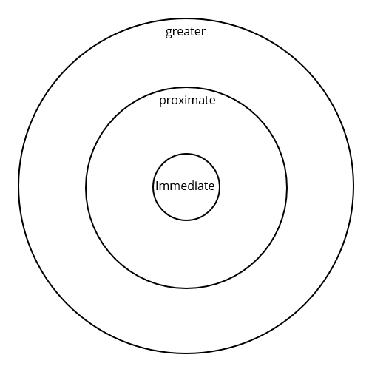
4. How are you nested in other structures and how are other structures nested within you?
The horticultural operations are nested within the whole of Brookside Farm. There are other wholes nested within Brookside Farm that may have relationships with the horticultural operations. We need to review them and see which need to be taken into consideration.
Skills audit, client interviews, find overlaps of common resources, infrastructure, limitations
Brookside
.
Gardening at Brookside
Notes:
Back to Prince Charles – lets think about what structures he is nested within. 2 mins
Now turn to page 4 of your worksheet and take a couple of minutes to fill in the diagram for your own life – try to come up with two or three.

Slide 27
Who do we go to in order to merge with the subject of our inquiry, experiencing it from the inside and surrendering all of our preconceptions about it’?
???
Nicola, Sharon, Rosemary, Ian
.
Bianca and Katie
Notes:
Back to Prince Charles – lets think about what structures he is nested within. 2 mins
Now turn to page 4 of your worksheet and take a couple of minutes to fill in the diagram for your own life – try to come up with two or three.

Slide 28
Aims/objectives
What are the quality of life statements for this project?

Slide 29
Doing
How is this all applied practically? How does the Lean Farm method link up?
Ben Hartman principles
Keep only tools that add value
Let the customer define value
Identify the steps that add value
Cut out the muda – anything that does not add value
Practice kaizen – continuous improvement

Slide 30
Define approach/ethos
Ben Hartman principles
Keep only tools that add value
Let the customer define value
Identify the steps that add value
Cut out the muda – anything that does not add value
Practice kaizen – continuous improvement
Non hierarchical structure
Clear, effective, authentic communication
Clear remit and specify needs
No plastic – is this possible?
Regenerative soil practices – Jesse Frost.
Start small and grow/keep it simple

Slide 31
Survey
What is currently in place?
Diagram of what is happening here
What would they like to see happen on the farm? Client survey
What is the market? Market research,
What are the resources on the farm/do we have? Map of farm regarding land, equipment, people, accommodation and other resources
What needs would we have? Client survey
What would we be giving up? Is it feasible for us, does it fit in to our quality of life statements?
Holistic decision making tool

Slide 32
Resources
Organic certification
People - volunteers
Accommodation
Equipment – shared resources
Land – feasibility of each area, issues
Irrigation
Propagation space – greenhouse??!
Propagation equipment
Office/planning space
Communication
Transport

Slide 33
Limiting factors
Lack of clarity
Communication
Conflicting needs for different spaces, e.g. the kitchen garden being used for growing herbs when there’s a whole field for herbs!

Slide 34
Brookside needs/wants
Help with gardening in the kitchen/rose garden
Help with site maintenance
Lovely green spaces
Waste cycling
Help with planning
Support with getting things done (e.g. aquaponics)

Slide 35
Needs
People – volunteers (need to ensure adequate systems in place for them)
Accommodation
Equipment – comprehensive list
Land – feasibility of each area, issues
Irrigation
Propagation space
Propagation equipment
Compost for prop
Office/planning space
Communication
Transport
Compost systems
Soil regeneration – mulch materials

Slide 36
2022
Summer/Autumn
Designs/plans
Learn about soil association demands
Systems for volunteers – induction, risk assessment, accommodation, the Hive set up, clear remit with task lists,
Growing areas prep – decompaction, weed removal, covering with cardboard and compost
Caravan prep (wood burner?)
Buy municipal and cover
Winter
Sort flat, sell surplus stuff

Slide 37
2023
Start growing

Slide 38
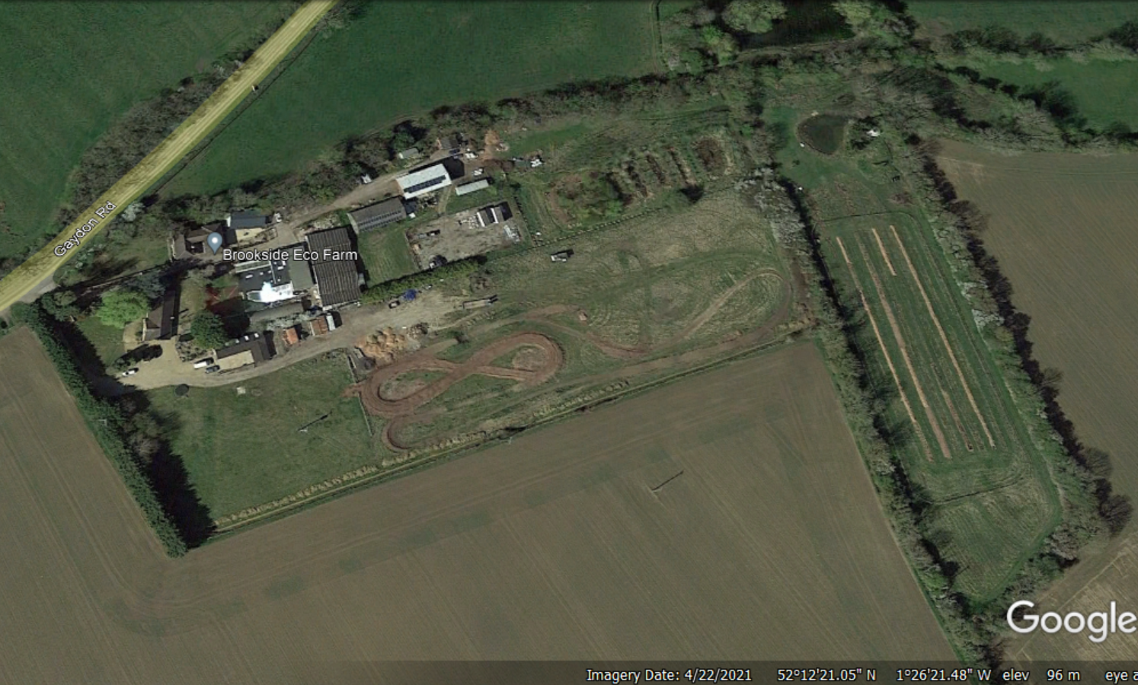

Slide 40
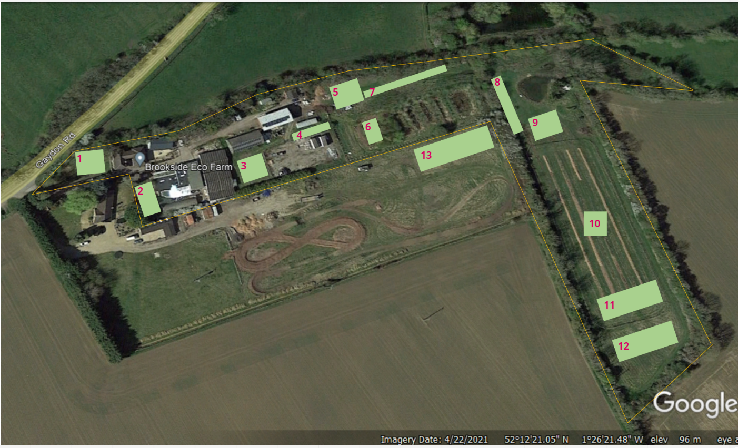

Slide 41
Zoning
There are different zones for different people – should we do zones for the growers, or zones for the family?

